Slide 1
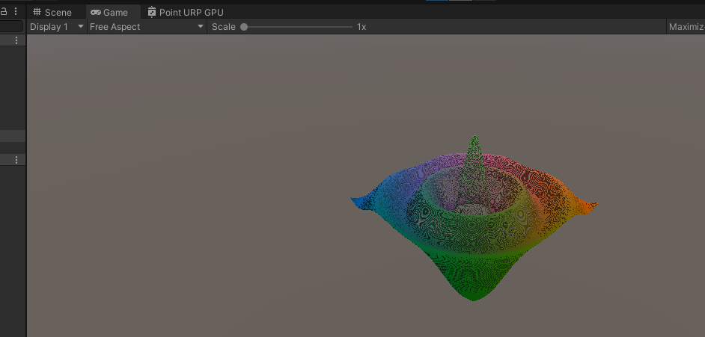
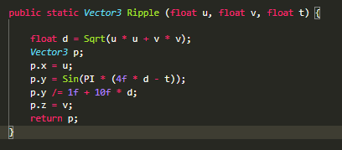
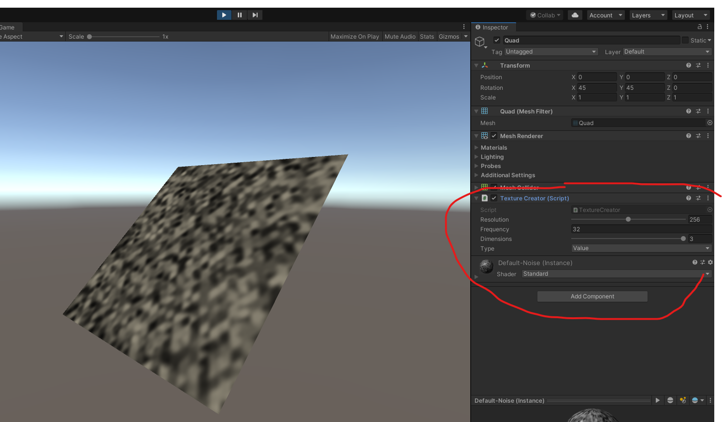

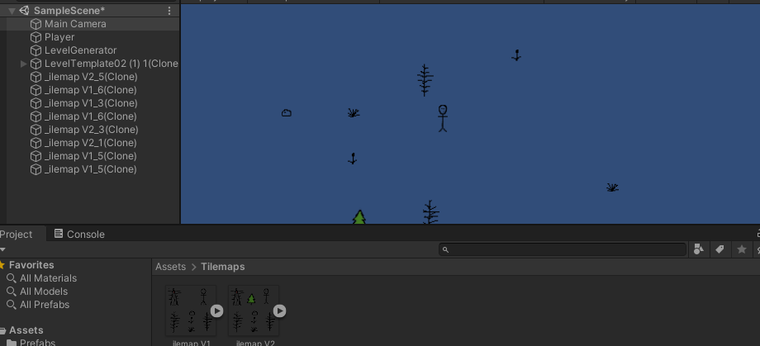
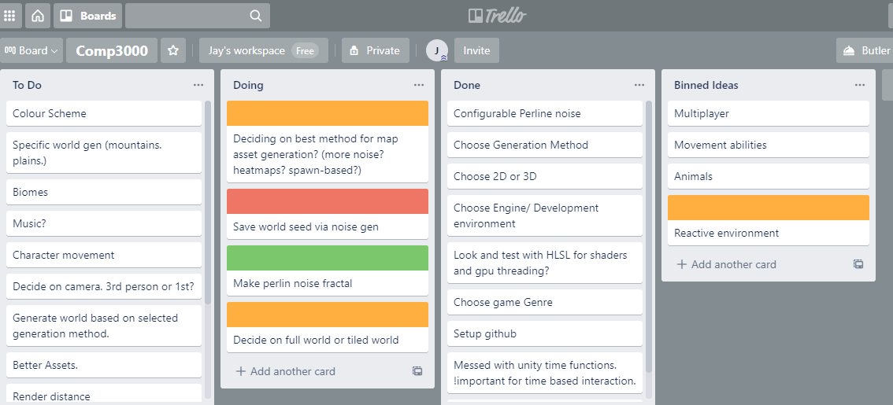
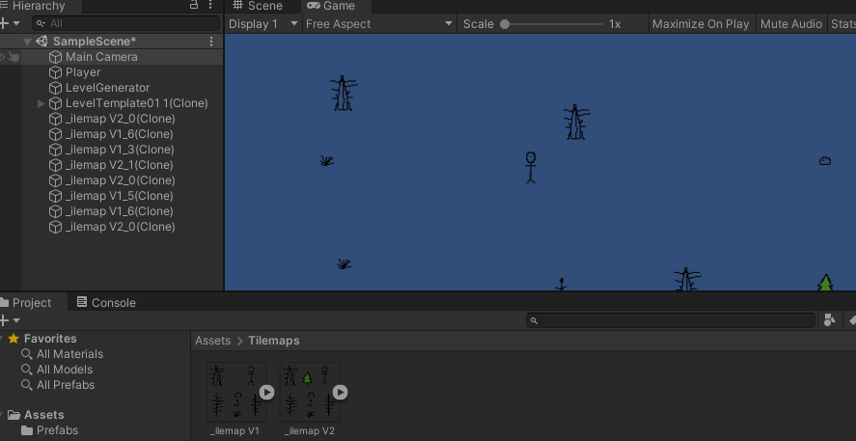
Current progress.
Basic exploration game
With procedural gen.
Early variant below (2D)
Notes:
So far. Customisable noise generation. Old version had spawn point based system, but I realised I could do better and learn it properly. The map should be saveable based on seed.

